Slide 1
Creating a Community
Social network with a common unity
Alfons Brink
Innovation advisor and
former coach of the TopAcademy

Slide 2
Nice to meet you!
Tell me about the introduction yesterday!

Slide 3
Alfons Brink (46)
Wife: Bianca
Children: Duncan(18), Esmee(15) and Zoë (8)
2001 Teacher Physical Education at Alfa-college
2003 Teamleader Human Technology
User centred design and marketing
Teacher of ergonomics and project management
Mentor (22 yrs)
Guidance counselor for students who do vocational training in real businesses
2017 Starting as program developer TopAcademy
2022 Master Healthy Ageing Professional (study of social innovations)

Slide 4
Impact
To share an event that changed my life as a teacher...

Slide 5
2 december 2010 10:00 hrs
The nightmare of every teacher and parent

Slide 6
Reflections
thoughts
Actions
I had doubts about my way of being a teacher and a counselor
Is this a healthy way for me because of my personal commitment to my students
Do I have to take some distance of my job?
School guidance counseling
Several talks with the parents
Spoken on his funeral
Mental coaching by a Psychologist
Accepting that personal coaching is my strength

Slide 7
Using qualities
Attention Deficit Hyperactive Disorder
Extrovert personality to make emotional contact with others
Hans Kuikman
Founding Father of the TopAcademy
Program developer & Senior Coach
The TopAcademy and our students gave me the believe that i can make a difference

Slide 8
This is me! The Greatest Showman

Slide 9
Community: a group of people with a common unity
Building a community

Slide 10
Let us Dream!

Slide 11
What do we see of a person?
Behaviour
Skills/ capabilities
Identity
Conviction
Personal values
Mission
Drives

Slide 12
Dare to Dream
If nothing or nobody could stop you, who would you wanna be?
If nothing or nobody could stop you, what skills do you want to have?
If nothing or nobody could stop you, what do you want to acchieve?

Slide 13
Your Goal
?
Notes:
This template was inserted from Power-user, the productivity add-in for PowerPoint, Excel and Word.
Install Power-user to access thousands of templates, icons, maps, diagrams and charts with Power-user.
Visit https://www.powerusersoftwares.com/
©Power-user SAS, terms of license: https://www.powerusersoftwares.com/terms

Slide 14
Making personal Goals
Step 1: What makes your goal attractive?
Step 2: Does it gives you the best feeling ever, when you achieve this goal tomorrow? (or do you have to addapt to a higher goal?)
Step 3: How are you going to achieve that goal? (So… Not when… but in what way?)
Step 4: Is your goal attainable??
Step 5: What is your goal worth to you?
Dare to Dream Big!

Slide 15
Answers: Describing personal goals
1
2
3
4
5
Notes:
This template was inserted from Power-user, the productivity add-in for PowerPoint, Excel and Word.
Install Power-user to access thousands of templates, icons, maps, diagrams and charts with Power-user.
Visit https://www.powerusersoftwares.com/
©Power-user SAS, terms of license: https://www.powerusersoftwares.com/terms

Slide 16
Let us find out what is important to you!

Slide 17
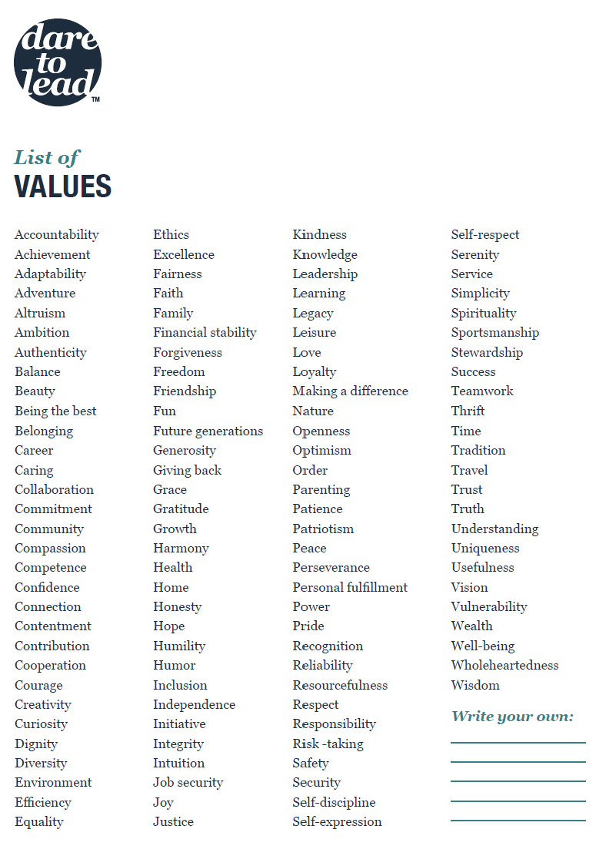
Values
Choose 15!
Delete 5
Delete another 5
Why these 5?
Are these values ​​reflected in your work?
How?

Slide 18
My Values
1
2
3
4
5
Notes:
This template was inserted from Power-user, the productivity add-in for PowerPoint, Excel and Word.
Install Power-user to access thousands of templates, icons, maps, diagrams and charts with Power-user.
Visit https://www.powerusersoftwares.com/
©Power-user SAS, terms of license: https://www.powerusersoftwares.com/terms

Slide 19
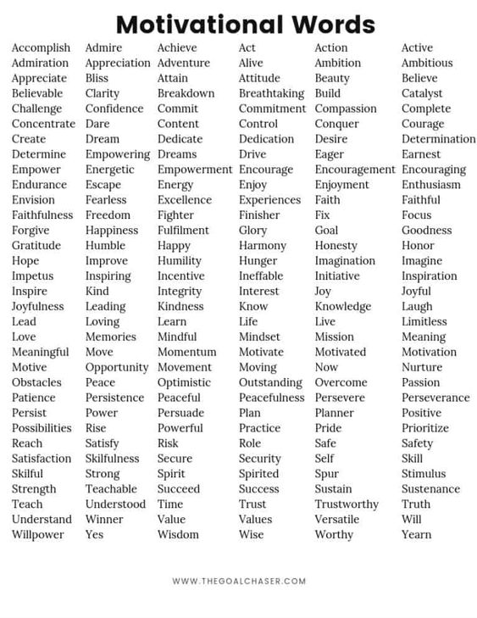
Motivation!
Choose 3!
Why these 3?
Are these motivations ​​reflected in your work?
How?

Slide 20
My Motivation
1
2
3
Notes:
This template was inserted from Power-user, the productivity add-in for PowerPoint, Excel and Word.
Install Power-user to access thousands of templates, icons, maps, diagrams and charts with Power-user.
Visit https://www.powerusersoftwares.com/
©Power-user SAS, terms of license: https://www.powerusersoftwares.com/terms

Slide 21
Back to your goal, connecting to your motivation
?
Notes:
This template was inserted from Power-user, the productivity add-in for PowerPoint, Excel and Word.
Install Power-user to access thousands of templates, icons, maps, diagrams and charts with Power-user.
Visit https://www.powerusersoftwares.com/
©Power-user SAS, terms of license: https://www.powerusersoftwares.com/terms

Slide 22
If you were completely free in your choice, what would you do RIGHT now?
Does this free choice resemble or connects to your dream that you worked out before?
YES!
No!
Take your next step!
What holds you back?

Slide 23
What is needed to achieve your Dream?
Who can help you or what do you need to do?
In what way do you invest in relationships…personal and professional?
Low hanging fruits

Slide 24
Journey of your goal!
1
Starting point of my goal
2
I am on my way, but I have to make some steps now!
3
Midway of my goal
4
5
I have achieved my goal
I am almost there, just some last steps

Slide 25
“Social Learning is about helping each other, building learning networks, solving problems together and sharing stories”.
Throughout the past two decades, there has been a growing body of literature that recognizes the importance of teachers’ interactions for their professional development.
(Moolenaar, 2012; Kyndt et al., 2016; Baker-Doyle and Yoon, 2020)

Slide 26
Social Capital a value/capital approach
Social capital represents the value of your network and the interplay of those involved (Boudrieu, Coleman, Putnam, Lin, Goshal & Nahapiet, Schoemaker).
The value arises from the nature, quality and accessibility of that network, which allows you to use each other's resources.
The more value we can assign to (your) a social system, the more valuable the system is for learning!

Slide 27
Social Capital a value/ capital approach
Social capital is what provides access to resources embedded in social relationships and enables people to mobilize these embedded resources to facilitate action.
Social capital needs three core concepts:
resource,
network structure and
network relationships.

Slide 28
There is no single social capital Theory

Slide 29
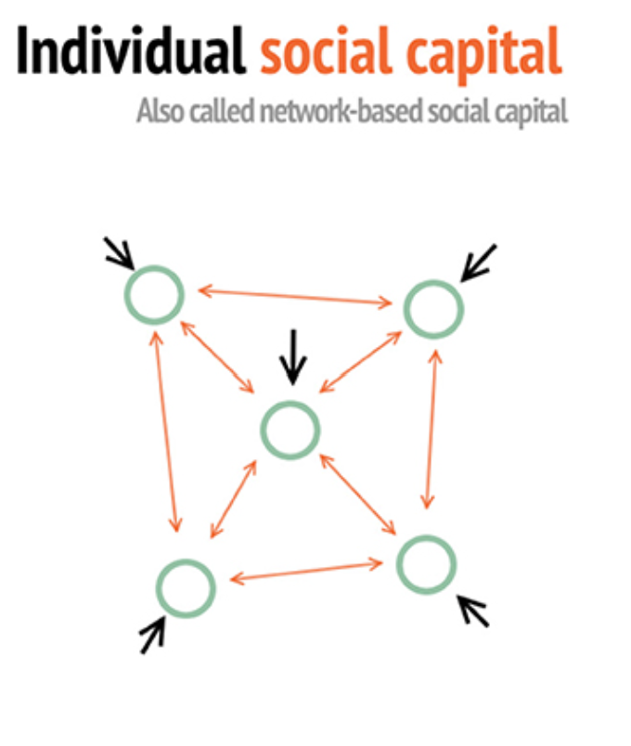
Let us create our own social learning network
(Coppe et al., 2021)

Slide 30
Your Network
Name
Name
Name
Name

Slide 31
What is needed to achieve your Dream?
Who can help you or what do you need to do?
In what way do you invest in relationships…personal and professional?
Use your Social Capital, put effort in the relationship
Low hanging fruits

Slide 32
Recap
To learn with and from each other
Share your Developmental goals
Building community with a social Capital
Get to know each other
Make a social connection
Share values
Tell your motives
Be authentic
Write them down
In what stage are you?
What is your first next step?
Pick up your low-hanging fruits
Determine who can help you
Know the importance of teacher interaction
Visualise the social network
Give value to your community
Share each other's resources
Put effort in your relationships

Slide 33
Creating Community Marca V. C. Wolfensberger Teaching for Excellence. Honors Pedagogies revealed (2012).
A commnunity of like-minded people offers student the possibility to:
Show initiative
Develop personal leadership
Develop social skills
To learn with and from each other
To maintain social contacts
To learn in a safe environment

Slide 34
Thank you for sharing….
Alfons Brink
ha.brink@alfa-college.nl

