Slide 1
Look! It’s not wat it seems…
A Theathers’ Road to Excellence

Slide 2
Introduction

Slide 3
How can ‘under-performing’ students be stimulated to make qualities visible and to excel?

Slide 4
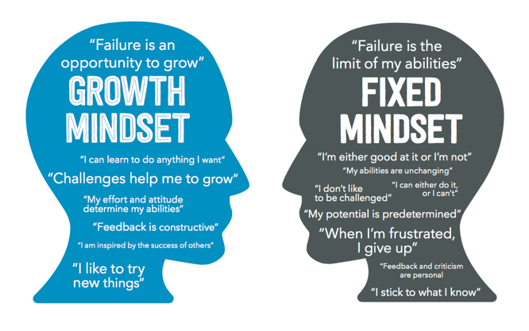
Literature Study
Self Determination Theory
Achievement Goal Theory
Fixed & Growth Mindset

Slide 5
How to recognize?

Slide 6
Growth & Fixed Mindset Theory By Carol Dweck
https://www.youtube.com/watch?app=desktop&v=KUWn_TJTrnU

Slide 7
In practice…..
Series of lessons
Lesson 1 | Introduction Fixed &Growth Mindset | Mindset test Introduction in Mindset theory
Lesson 2 | Cases | Worksheet with cases; Get started in groups
Lesson 3 | Deepening in theory | More information on fixed & growth mindset
Lesson 4 | Get started with mindset | Practice with thoughts and changing words
Lesson 5 | Closing | Second time mindset test Additional interview

Slide 8
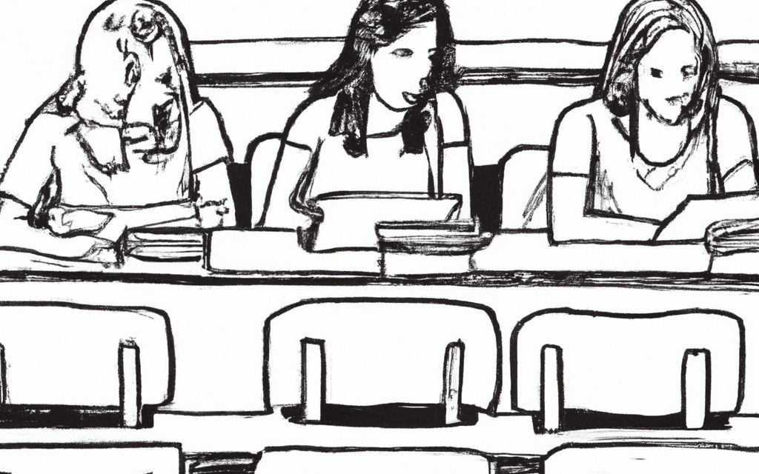
In the Classroom
Test your mindset…

Slide 9
Working in small groups
What would you do in this case?
Is your way of thinking growth or fixed?
What do you have to do to make it into a growth mindset?

Slide 10
More about fixed & Growth Mindset
https://www.google.com/search?q=fixed+en+growth+mindset&rlz=1C1GCEA_enNL891NL891&sxsrf=APwXEdeEJlZ3Wtn9gIfpN2rQ-3Um1KUEsw:1682499193563&source=lnms&tbm=vid&sa=X&ved=2ahUKEwj9jov2lcf-AhUwVqQEHf6rCXQQ_AUoA3oECAEQBQ&biw=1514&bih=706&dpr=1.25#fpstate=ive&vld=cid:6fb33d96,vid:M1CHPnZfFmU

Slide 11
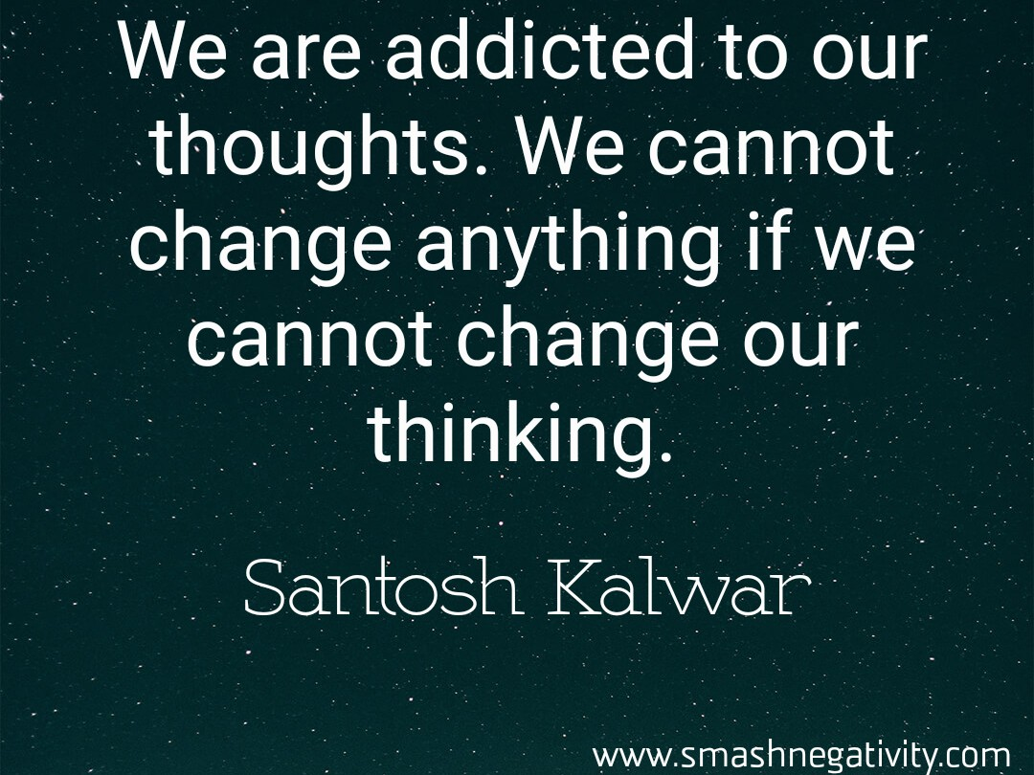
Fixed Mindset; negative thoughts
*You’re not alone
*Where do they come from?
Negative thougths mainly come from beliefs. Your beliefs determine the way you look at everything; To yourself, other people, your life and your challenges.

Slide 12
Examples of beliefs that promote negative thoughts
1. I’m not good enough. 2. I can always do better. 3. I have to do as well as other people. 4. Other people must like me. 5. The opinion of another determines who I am. 6. I can’t except my weaknesses. 7. I must have total certainty about the future.

Slide 13
A belief is not truth

Slide 14
Conversations
- Choose a duo
- Discuss in response to the negative thoughts from the previous slides;
*Which one do you sometimes recognize in yourself?
*In what situation does that occur?
*What happens in this situation after you have had the thought?
- As a result of your conversation, both write down a thought that you most often recongnize in yourself

Slide 15
Growth Mindset: Think Positive
How reverse a fixed mindset?
https://www.youtube.com/watch?v=g7u6UwtmGyE&t=19s

Slide 17
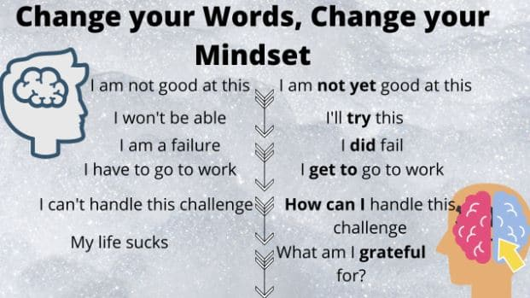
Change your language
Make duo’s again
Use the tought you jotted down earlier in the conversation
Discuss together wich language you could use with this thought
Discuss and then write down for yourself when and in wich situation you want to apply this ‘change idea’

Slide 18
Results?

Slide 19
How to coach your students towards a growth mindset?
1. Your brain and abilities can only grow
2. Prioritize effort over results
3. Use the word ‘YET’
4. Be alert to effort, even if the results are not (yet) there
5. Allowed to make mistakes

Slide 20
Fixed&Growth Mindset; Carol Dweck explains
https://www.youtube.com/watch?v=hiiEeMN7vbQ

Slide 21
Bounded freedom
The student can decide on process and contents of the assignment by offering choices in:
Themes
Assignment
Teaching format (werkvorm)
Choices which are meaningful for the students and thus connect to their own motivation

Slide 22
In practice…..
Series of lessons
Lesson 1 | Introduction Fixed &Growth Mindset | Mindset test Introduction in Mindset theory
Lesson 2 | Cases | Worksheet with cases; Get started in groups
Lesson 3 | Deepening in theory | More information on fixed & growth mindset
Lesson 4 | Get started with mindset | Practice with thoughts and changing words
Lesson 5 | Closing | Second time mindset test Additional interview

